Slide 1
Where is this?
Why are the houses painted like this?
Would you want your house to be painted like this?

Slide 2
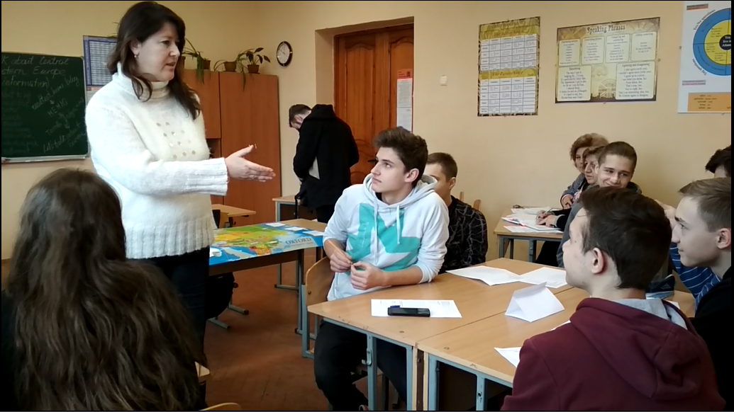
Створення сприятливого мовленнєвого середовища на уроках іноземної мови.
Підготувала: викладач Благодарна Т.І.

Slide 3
Teenagers are moody!
They can change from
☹ to ☺
quickly!

Slide 4
They’re addicted to their phones.
They’re digitally competent!

Slide 5
They challenge authority.
They’re preparing for independence
!

Slide 6
They can seem disconnected with the real world and bored.
Once engaged, they can be enthusiastic and committed.

Slide 7
Active Learners
Think for themselves
Question and discuss
Produce their own responses

Slide 8
The Creative Classroom Challenging beginnings Discussion and debate Talk about the Real World
Critical thinking (lower level)

Slide 9
In the 21st century, why do I need a teacher when I`ve got ?

Slide 10
Higher order
Create
Evaluate
Analyze Apply Understand Remember
Creative thinking
Critical thinking
Lower order
Comprehension and use

Slide 11
write a story, make a video, present your views
Higher order
Create
Evaluate
Analyze Apply Understand Remember
ask your own questions, identifying arguments, perspective and bias,
giving reasons and opinions, problem-solving
drills, gapfills, multiple choice, fill in a table, comprehension questions, translation, copying from the board, match to pictures
Lower order

Slide 12
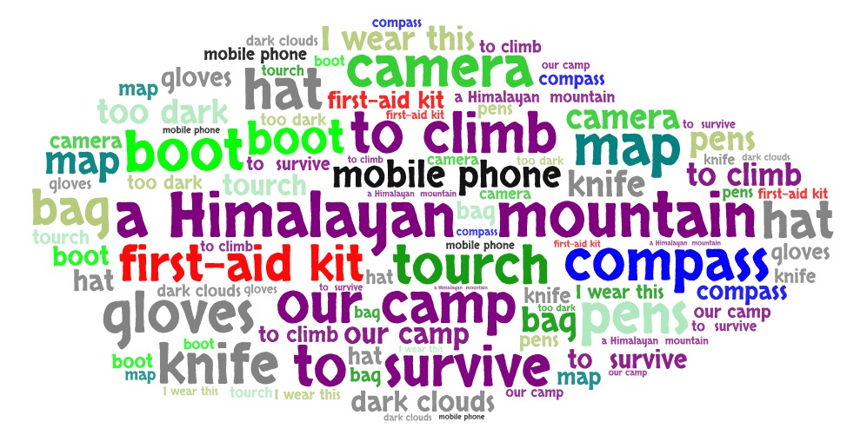

Slide 13
Life Elementary Unit 2, National Geographic Learning

Slide 14
Complete these sentences with a word.
I wear this_____ on my head.
Put these ____ on your hands.
It’s too dark. Switch the____ on.

Slide 15
Tell your partner which of these objects…
are in your bag today?
do you have at home?

Slide 16
Work in groups. Imagine you have to survive for one night on the side of a Himalayan mountain.
Rank these objects in order of importance from 1 to 11.

Slide 17
Write a short story that begins with this sentence:
“When we left our camp the sun was shining. But as we started to climb, the sky filled with dark clouds.‘

Slide 18
Choose the correct word in each question.
Where do/does you live?
What is/are your favourite sport?
Why do/does she study medicine?
Write questions for the answers.
breakfast? At eight o’clock every morning.
in the evening? She likes watching TV.
history?
She wants to become an archaeologist.
Write three more questions and ask your partner.
What…
Where..
Why…

Slide 19
because

Slide 20
Reliability
1 = Not a reliable source
2 = It might be credible but I’d have to check the information in another source as well
3 = It’s usually a very credible source of information
An article in a newspaper
A post on Facebook
A video on YouTube
A published book by a qualified specialist on the subject
An entry on Wikipedia
A documentary on TV with interviews with real people

Slide 27
Critical thinking in the ELT classroom leads to…
questioning and independent thinking skills
deeper processing of language
motivational classroom activities

Slide 28
In the 21st century, why do I need a teacher when I`ve got ?
In the 21st century, I need a teacher more than over as a result of !

